Slide 1
Musical Library DBMS
By Reid Trisler and Ke’gn Hart

Slide 2
Application Domain: Area of Application
Many applications have music streaming services that must be well organized in order to be user-friendly
Records of song, album, and artist names are essential for a user to find their music
Could be applied to:
Very large music-streaming services with thousands of songs
Simple, user-based library for organizing music for personal use
Radio station

Slide 3
Application Domain: Challenges
Keeping a Artist’s music all together must be achieved by having a single entity for one Artist and all associated music
All of an Artist’s songs and features must be on their page to ensure publicity
To minimize redundancy, songs with the same name, from the same artist will be considered duplicates and deleted
Users must be able to easily access all music, whether in their library, or in search

Slide 4
Problem Statement:
Entities & Relationships
The entities included in our database will consists of Songs, Albums, Artists, Label Companies(Labels), and Users
The relationships between each other is as follows:
Songs BELONG to Albums
Artists MAKE Songs
Users LISTEN to Songs
Users RATE Songs
Labels MANAGE Artists
Publishers PUBLISH Albums

Slide 5
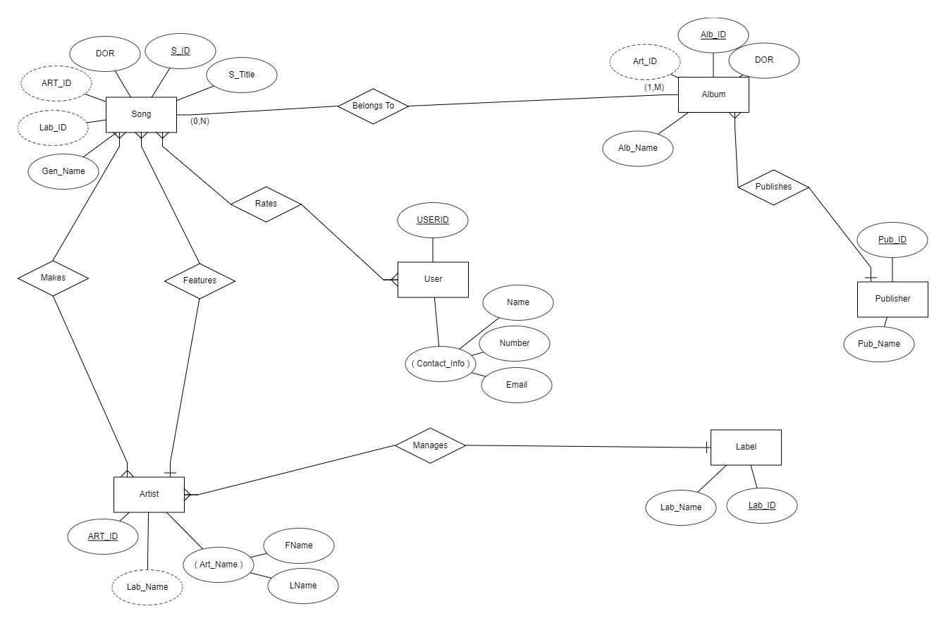
E/R Model

Slide 6
Constraints:
Artist is essential to the creation of a Song, although an Artist will not be in the database until it has Made a Song
Artist is also essential to the creation of a Label, since the Label will not appear in the database until it has Managed an Artist
User can only Rate a Song once, so the overall Rating will be an average of many User Ratings
Publisher
An album can only have one publisher, but publishers can publish any number of albums

Slide 7
Constraints:
Songs and Albums:
A Song MUST have an Artist that sings/owns it, does not need to BELONG to an Album
A Song can be OWNED by ONE Artist but FEATURE many Artists, BELONG to many Albums, and be LISTENED to by many Users
An Album has many Songs, can be from only one or many varying Artists
Artists, Labels, and Users:
An Artist can MAKE only one Song with the same name, can sing many Songs on an Album
An Artist can be MANAGED by only one Label, but does not need a Label
Label can MANAGE many Artists
Users can RATE many Songs, but songs receive ONLY ONE rating from User.

Slide 8
Timeline of Tasks & Responsibilities
1/21
1/28
2/4
2/11
Schemas & Behaviors
DDL Commands
DML Commands
User Interface
Have complete model of all relative Schemas and the Constraints applied to them.
Create DDL Commands for imported/created data.
Create queries for organizing this data.
Implement UI for ease of access.

